Slide 1
Turbidity Test of Water
By
Devansh Wadhwani – (64)
Diksha Utekar – (63)
D15A INFT

Slide 2
Project Objective
Arduino-based system to measure water turbidity.
Uses a turbidity sensor to display real-time readings.
Useful for environmental monitoring and water quality.

Slide 3
Components Used
Arduino UNO R3
Turbidity Sensor (SEN0189)
16x2 LCD Display (with I2C)
Jumper Wires
USB Cable

Slide 4
Technical specifications of Components
Arduino UNO | Turbidity Sensor (SEN0189) | 16x2 LCD Display (I2C) | Jumper Wires | USB Cable
5V operating voltage 14 digital I/O pins, 6 analog inputs 16 MHz clock speed 32 KB flash memory | 5V supply voltage 0–1000 NTU measurement range Analog output signal Waterproof sensor head | 5V operating voltage 16 characters × 2 lines I2C communication (only 2 pins) Adjustable contrast | For quick connections Male/Male, Male/Female, Female/Female | USB A to B type Used for programming and powering Arduino

Slide 5
Pin Connections - Turbidity Sensor
VCC to 5V
GND to GND
Signal to A0

Slide 6
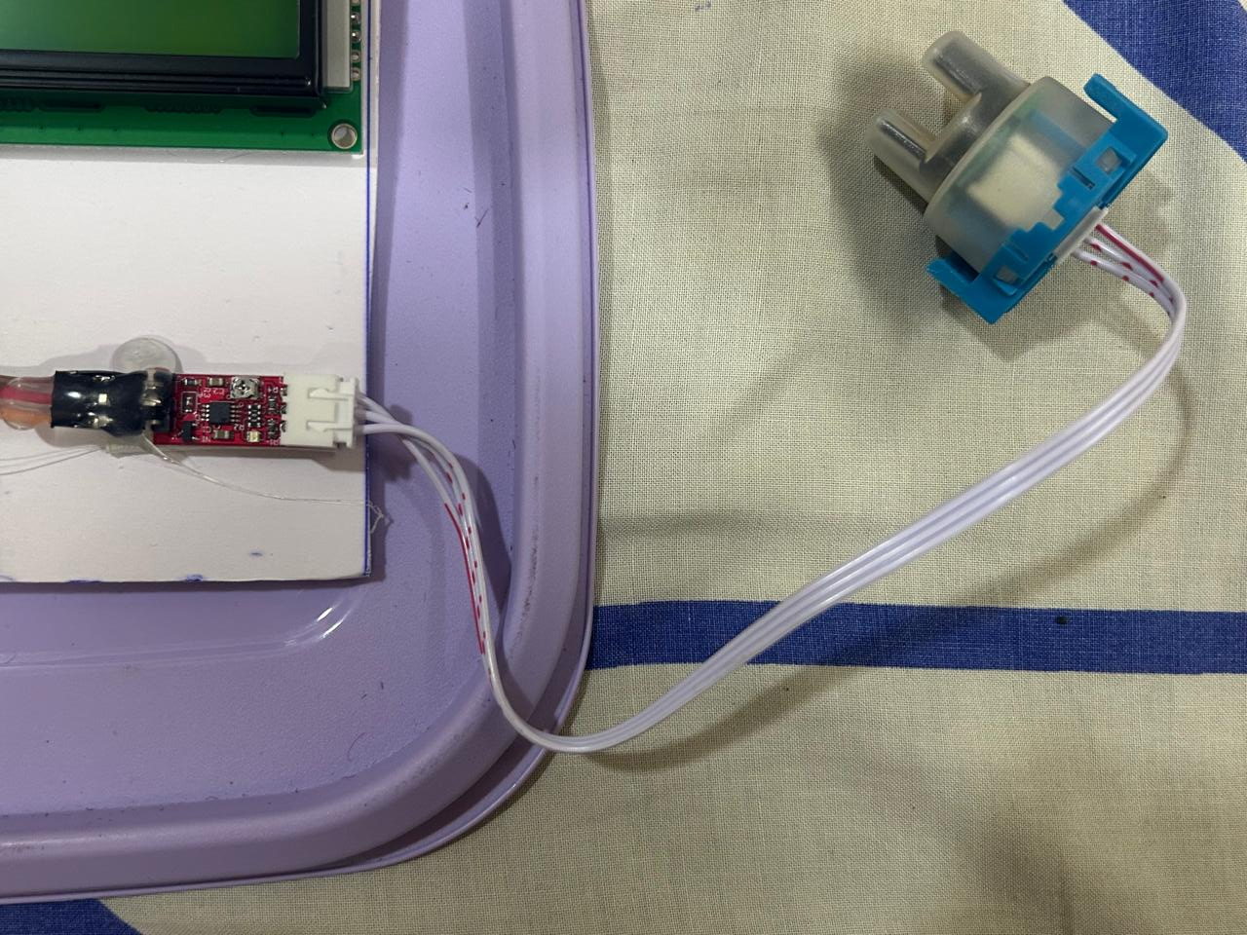
Turbidity Sensor Connection

Slide 7
Pin Connections - LCD (I2C)
VCC to 5V
GND to GND
SDA to A4
SCL to A5

Slide 8
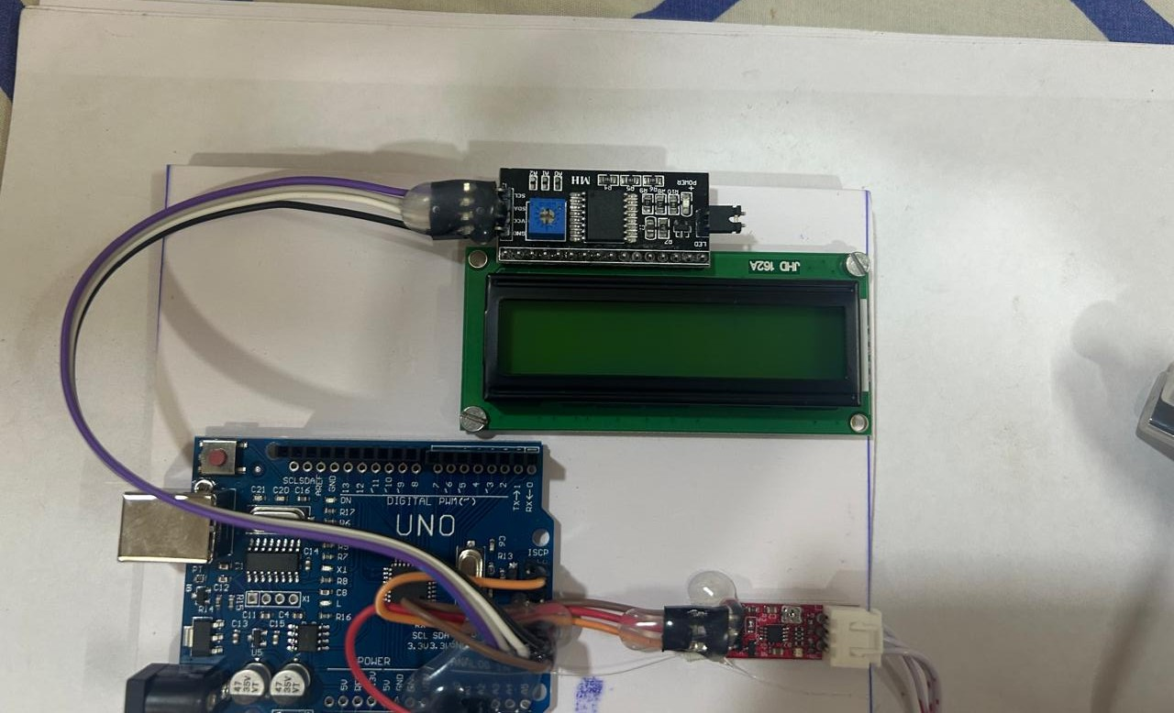
LCD CONNECTIONS WITH ARDUINO

Slide 9
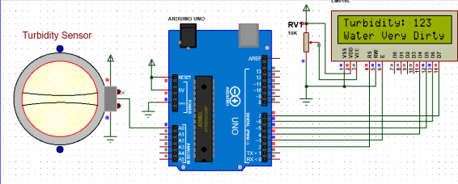
Circuit Diagram

Slide 10
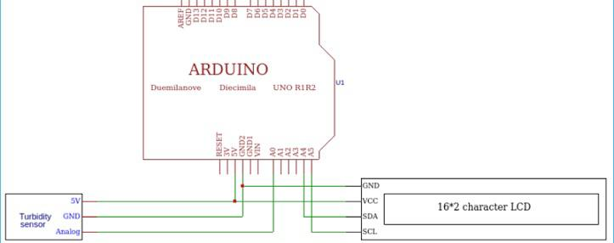
Schematic Diagram

Slide 11
Procedure - TinkerCAD Simulation
Simulate Arduino UNO and verify LCD.
Connect turbidity sensor.
Run sample codes.
Display Turbidity on LCD.

Slide 12
Procedure - Physical Implementation
Connect LCD and turbidity sensor.
Upload and run code.
Test with various water samples.
Monitor LCD for turbidity readings.

Slide 13
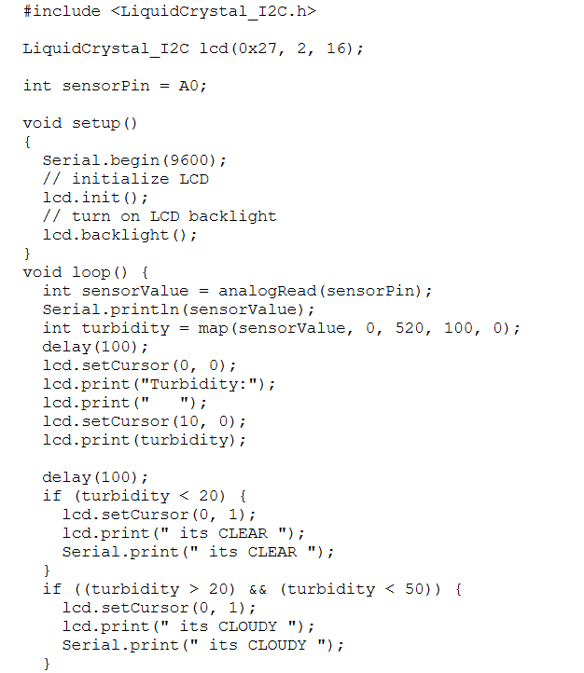
Arduino Code (Part 1)

Slide 14
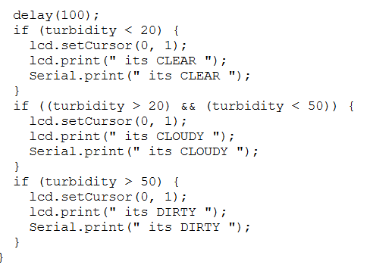
Arduino Code (Part 2)

Slide 15
Explanation of Code
Initializes and sets up the LCD.
Reads sensor's analog values.
Judges the Purity of Water Sample
Displays turbidity readings on LCD.

Slide 16
Applications
River and lake pollution monitoring
Industrial wastewater analysis
Aquaculture
Drinking water quality testing

Slide 17
Conclusion
Learned sensor integration with Arduino.
Displayed and interpreted turbidity levels.
Built a practical environmental tool.

